Slide 1





AniHub
DATABASE
PROJECT
Presented by:
Sadman Sakib
&
Taskeen Alam Towfique

Slide 2

Overview
System Overview
Database Structure
User Interface
Search and Filtering
Data Entry and Update
Reporting and Analytics
Integration with External System

Slide 3


System Overview
The Anime Database Management System is a comprehensive software solution designed to efficiently manage and organize anime-related data. It serves as a centralized platform for storing, retrieving, and updating information about anime series, episodes, characters, and more. The system offers a range of features and benefits that enhance the management and accessibility of anime data.

Slide 4


System Overview
Purpose
Feature
Benefits
The Anime Database Management System is designed to efficiently store, organize, and retrieve information about anime series, episodes, characters, and related data.
Comprehensive database for storing anime series, episodes, characters, and related information.
User-friendly interface for easy navigation and search functionality.
Ability to add, edit, and delete anime entries, episodes, and characters.
Integration with external APIs to fetch additional data such as ratings, reviews, and recommendations.
Efficient management and organization of anime data, improving productivity and accuracy.
Quick and easy access to information, enabling faster decision-making and data retrieval.
Enhanced collaboration and sharing of anime-related data among users.

Slide 5


Database Structure
Entity Sets
Relations
Anime
User
Comment
Characters
Voice Actor
Anime Genres
Ratings
Favorites
Followers
Reply
Studio
Soundtracks
Trailer
Season
Episode
Keywords
Watch List
Review
User to Watch List ( One to Many )
User to Anime ( Many to Many via Ratings )
User to Favorites ( One to Many )
User to User ( Many to Many via Followers )
User to Comments ( One to Many )
Comments to Reply ( One to Many )
Anime to Studio ( Many to Many )
Anime to Episodes via Season ( One to Many )
Anime to Trailer ( One to Many )
Anime to Soundtracks ( One to Many )
Anime to Characters ( One to Many )
Anime to Genre ( Many to Many via Anime_Genre)
Anime to Favorite ( One to One )
Characters to Voice Actors ( Many to many via cast )
Anime to keywords ( Many to Many )

Slide 6
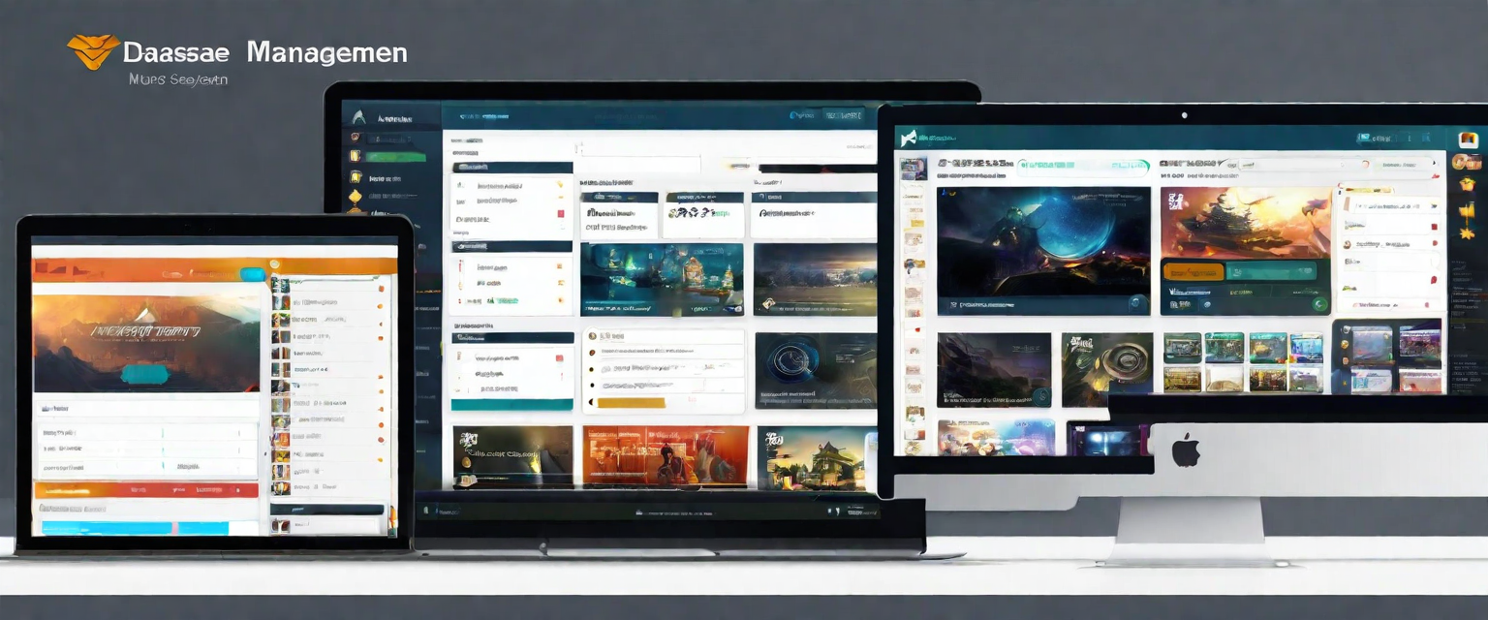
User Interface
Design and Layout
Intuitive Navigation
The Anime Database Management System features a modern and clean design, with a user-friendly layout that allows for easy navigation and efficient data management.
The user interface of the system offers intuitive navigation, making it easy for users to search, filter, and manage anime data. The navigation menu and search bar are prominently displayed, allowing users to quickly access the desired features and information.

Slide 7





Search and Filtering
The Anime Database Management System provides users with powerful search and filtering capabilities to find specific anime based on various keywords.
Users can search for anime by genre, allowing them to find shows that match their specific interests.
Users can filter anime based on rating, enabling them to discover shows that have been highly rated by other users.
Users can also search for anime based on release date, allowing them to find shows that were released during a specific time period.

Slide 8




Data Entry and Update
Add new Anime
This feature allows users to contribute to the database by entering essential details such as the anime title, genre, release year, and other relevant information. This ensures a dynamic and constantly updated collection of anime.
Update Existing Anime
This functionality enables users to modify and enhance the existing anime records. This includes the ability to edit details like the title, genre, release year, or any other relevant information, ensuring that the database remains current and reflects accurate data
Data Validation
Includes data validation checks to ensure the accuracy and integrity of the entered information, such as checking for duplicate entries or invalid data.

Slide 9

Reporting and Analytics
Anime Popularity
Generate reports on the most popular anime series based on user views and ratings.
Track the popularity trends of anime genres over time.
Rating Analysis
Generate reports on the average ratings of anime series and movies.
Analyze user ratings to identify trends and patterns in anime preferences.
User Preferences
Track user preferences and generate reports on popular anime genres, characters, and themes.
Analyze user interactions and behavior to personalize anime recommendations.

Slide 10



Integration with External Systems
Streaming Platforms
Social Media
Analytics Tools
Seamless integration with popular streaming platforms.
Allows users to watch anime directly within the Anime Database Management System.
Integration with popular social media platforms for easy sharing of anime recommendations and reviews.
Allows users to connect with friends and discover new anime through social networks.
Integration with analytics tools to track anime popularity and user engagement.
Provides data and insights to optimize content recommendations and marketing strategies.

Slide 11


Team Members
Sadman Sakib
Taskeen Alam Towfique
2105121
2105122

Slide 12




AniHub
THANK YOU
For watching this presentation
01718519272 or 01948041522
sakib519272@gmail.com
taskeen20021@gmail.com
Buet

